Slide 1
LECTURE 7
THE USES OF DIGITAL AUDIO IN MULTIMEDIA
Notes:
SCA 3103 - Introduction to Multimedia
Lecture 7

Slide 2
Objective
What is sound?
  Waveforms and attributes of sound
Capturing digital audio
  Sampling
MIDI (Musical Instrument Digital Interface)
Notes:
SCA 3103 - Introduction to Multimedia
Lecture 7

Slide 3
Sound
Sound comprises the spoken word, voices, music and even noise.
It is a complex relationship involving a vibrating object (sound source), a transmission medium (usually air), a receiver (ear) and a perceptor (brain). Example banging drum.
As the sound vibrates it bumps into molecules of the surrounding medium causing pressure waves to travel away from the source in all directions

Slide 4
Sound
So, Sound are rapid vibrations that are transmitted as variations in air pressure.

Slide 5
Waveforms
Sound waves are manifest as waveforms
  A waveform that repeats itself at regular intervals is called a periodic waveform
  Waveforms that do not exhibit regularity are called noise
The unit of regularity is called a cycle
  This is known as Hertz (or Hz) after Heinrich Hertz
    One cycle = 1 Hz
    Sometimes written as kHz or kiloHertz (1 kHz = 1000 Hz)

Slide 6
Waveforms
Time for one cycle
distance
along wave
Cycle

Slide 7
The characteristics of sound waves
Sound is described in terms of two characteristics:
  Frequency
  Amplitude (or loudness)
Frequency
  the rate at which sound is measured
  Number of cycles per second or Hertz (Hz)
  Determines the pitch of the sound as heard by our ears
  The higher frequency, the clearer and sharper the sound→the higher pitch of sound

Slide 8
The characteristics of sound waves
Amplitude
  Sound’s intensity or loudness
  The louder the sound, the larger amplitude.
In addition, all sounds have a duration and successive musical sounds is called rhythm

Slide 9
The characteristics of sound waves
Amplitude
Time for one cycle
pitch
distance
along wave
Cycle

Slide 10
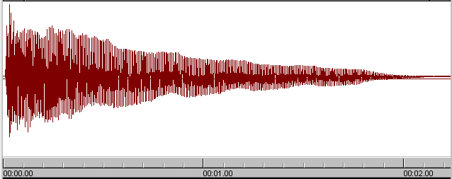
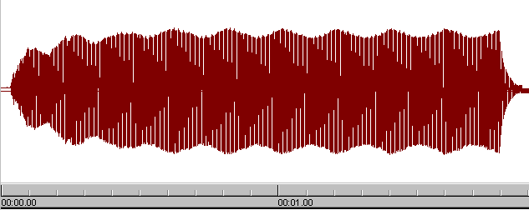
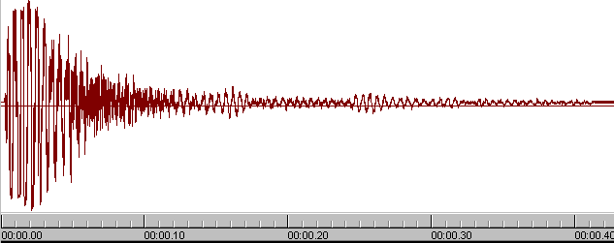
Example waveforms
Piano
Pan flute
Snare drum

Slide 11

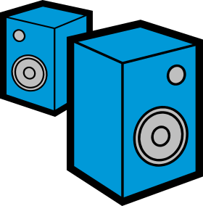
Capture and playback of digital audio
Air pressure
variations
Digital to
Analogue
Converter
Converts back into voltage
DAC
Captured via
microphone
Signal is
converted into
binary
(discrete form)
0101001101
0110101111
Analogue
to Digital
Converter
ADC
Air pressure
variations

Slide 12
The Analogue to Digital
Converter (ADC)
An ADC is a device that converts analogue signals into digital signals
An analogue signal is a continuous value
  It can have any single value on an infinite scale
A digital signal is a discrete value
  It has a finite value (usually an integer)
An ADC is synchronised to some clock

Slide 13
The Analogue to Digital
Converter (ADC)
It will monitor the continuous analogue signal at a set rate and convert what it sees into a discrete value at that specific moment in time
The process to convert the analogue to digital sound is called Sampling. Use PCM (Pulse Code Modulation)

Slide 14
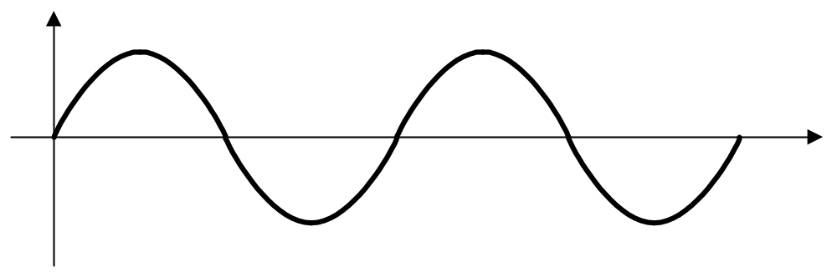
Digital sampling
Sampling frequency
Notes:
SCA 3103 - Introduction to Multimedia
Lecture 7

Slide 15
Digital sampling
Sampling frequency
Notes:
SCA 3103 - Introduction to Multimedia
Lecture 7

Slide 16
Sampling
Two parameters:
Sampling Rate
  Frequency of sampling
  Measure in Hertz
  The higher sampling rate, higher quality sound but size storage is big.
  Standard Sampling rate:
  - 44.1 KHz for CD Audio
  - 22.05 KHz
  - 11.025 KHz for spoken
  - 5.1025 KHz for audio effect

Slide 17
Sampling
Size sample
The resolution of a sample is the number of bits it uses to store a given amplitude value, e.g.
  8 bits (256 different values)
  16 bits (65536 different values)
  A higher resolution will give higher quality but will require more memory (or disk storage)

Slide 18
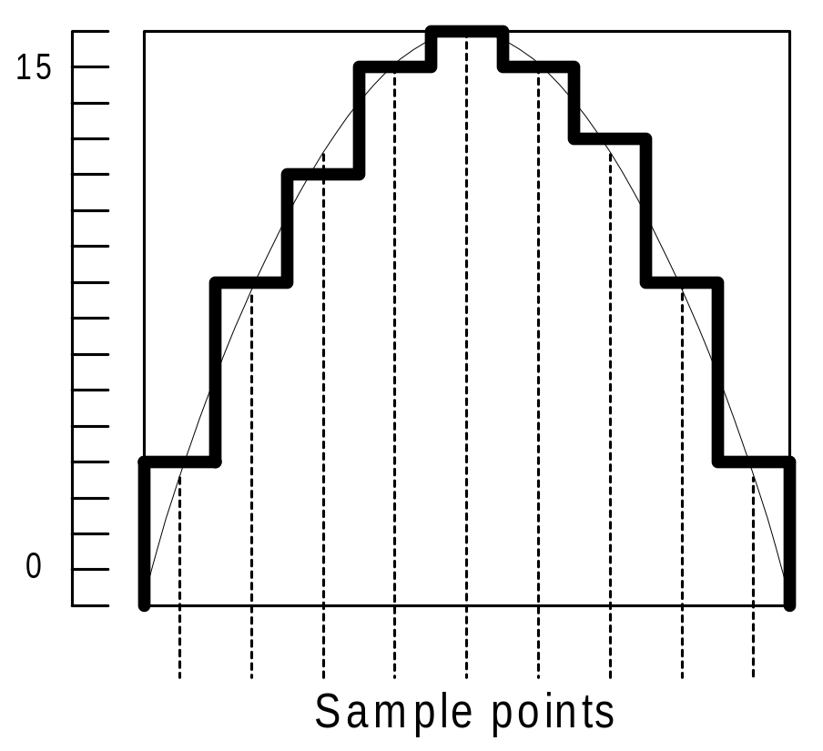
Quantisation
Samples are usually represented the audio sample as a integers(discrete number) or digital

Slide 19
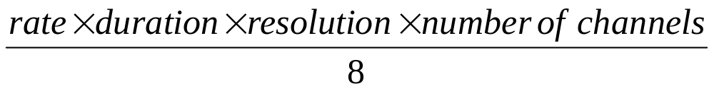
Calculating the size of digital audio
The formula is as follows:
The answer will be in bytes
Where:
  sampling rate is in Hz
  Duration/time is in seconds
  resolution is in bits (1 for 8 bits, 2 for 16 bits)
  number of channels = 1 for mono, 2 for stereo, etc.

Slide 20
Calculating the size of digital audio
Example:
Calculate the file size for 1 minute, 44.1 KHz, 16 bits, stereo sound
Where:
  sampling rate is 44,100 Hz
  Duration/time is 60 seconds
  resolution is 16 bits
  number of channels for stereo is 2

Slide 21
Calculating the size of digital audio
44100 * 60 * 16 *2
8

Slide 22
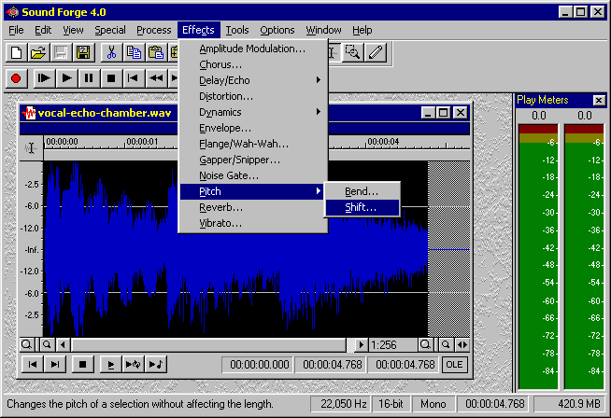
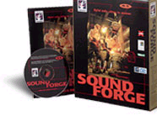
Digital audio editing software
One of the most powerful and professional PC-based packages is a tool called Sound Forge
  http://www.sonicfoundry.com/

Slide 23
Editing Digital Audio
Trimming
Splicing and assembly
Volume adjustments
Format conversion
Resampling or downsampling
Fade ins and fade outs
Equalization
Time Stretching
Digital Signal processing
Reversing Sounds

Slide 24
Editing Digital Audio
Simple audio editing software allows:
  Recording of digital audio segments
  Trimming
  Splicing and assembly
  Volume adjustments of the entire segment
  Reversing Sounds
  Copy, cut, paste and delete segments of digital audio
Others audio editing software:
  COOL Edit Pro
  Gold Wave
  PROSONIQ SonicWORX
  Samplitude Studio

Slide 25
Audio formats
Depend on O/S. For examples:
  AIFF (Audio Interchange File Format)
  SOU
    For Macintosh
  .WAV
    Waveform file format. For Windows/Microsoft
  .VOC
    Sound Blaster Card

Slide 26
What is WAV?
WAV is an audio file format that was developed by Microsoft.
It is so wide spread today that it is called a standard PC audio file format.
A Wave file is identified by a file name extension of WAV (.wav).
Used primarily in PCs, the Wave file format has been accepted as a viable interchange medium for other computer platforms, such as Macintosh.

Slide 27
What is WAV?
This allows content developers to freely move audio files between platforms for processing,
For example. The Wave file format stores information about
  the file's number of tracks (mono or stereo),
  sample rate
  bit depth

Slide 28
What is WAV?
Pros
Can be played by nearly all Windows applications that support sound
Fast decoding
Cons
Very large file size

Slide 29
MIDI (Musical Instrument Digital Interface)
MIDI is a standard for specifying a musical performance
Rather than send raw digital audio, it sends instructions to musical instruments telling them what note to play, at what volume, using what sound, etc.
The synthesiser that receives the MIDI events is responsible for generating the actual sounds. Example: Keyboard Piano

Slide 30
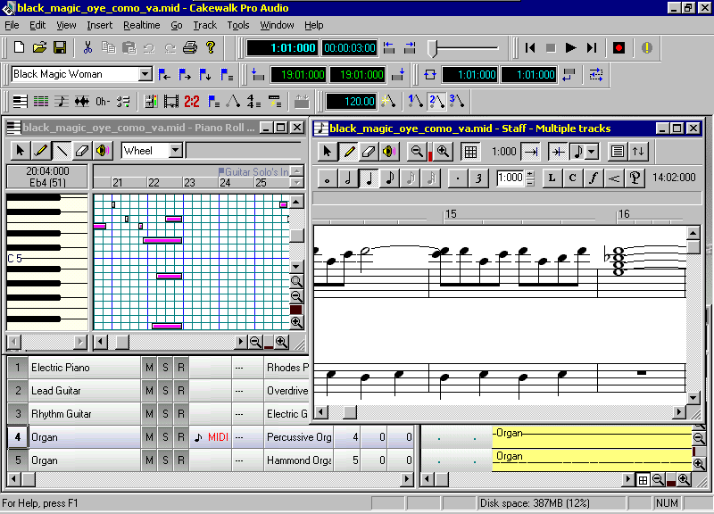
MIDI sequencers
A MIDI sequencer allows musicians to edit and create musical compositions like a word processor
  Cut and paste
  Insert / delete

Slide 31
MIDI Versus Wav
Quality recording, MIDI depend to the tools
Audio .wav easier to create compare than MIDI
MIDI Advantages
  File Size small
  Size Storage also small
MIDI Advantages
  Playback
  Cost and Skill

Slide 32
How audio can be used effectively
Examples of uses of audio:
Cautions and warnings
It is a good medium for alerting users to critical information. Some uses include:
  Sounding an alarm when a limit is reached
  Alerting users when data is entered incorrectly
Music and Sound Effects
These make multimedia interaction more real. Some uses include:

Slide 33
How audio can be used effectively
  Musical background for a video segment
  Birds Songs accompanying photographs in biological field training.
Sound-related data.
Some uses include:
  Helping mechanics diagnose engine trouble
  Training medical students to recognize different breathing sounds

Slide 34
How audio can be used effectively
Direct voice communication.
Some uses include:
  Leaving a voice message for other users of an application
  Consulting with an expert during a troubleshooting procedure.

Slide 35
Advantages and Disadvantages of using audio
Sound adds life to any multimedia application and plays important role in effective marketing presentations.
Advantages
  Ensure important information is noticed
  Add interest
  Can communicate more directly than other media

Slide 36
Advantages and Disadvantages of using audio
Disadvantages
  Easily overused
  Requires special equipment for quality production
  Not as memorable as visual media

Slide 37
Summary
There are two main types of digital audio
  Sampled audio
    Captured by sampling an analogue waveform at a set rate
  MIDI data
    Instructions on how to perform some musical composition
Sampled audio requires more storage space than MIDI information

